Slide 1
The Development and Implementation of Low-Level Control Strategies for a Robust and Effective Low-Cost Rehabilitation Robot for Home Use.
Adam Metcalf
Supervisors: Prof Martin Levesley, Dr Justin Gallagher, Dr Andrew Jackson

Slide 2
Strokes are bad - frequency

Slide 3
Strokes are bad – Greying of the population

Slide 4
Stroke effects
Impaired movement control – deficits persist in approximately half of patients 6 months post stroke
Spasticity – An increase in muscle tone
Hemiparesis – Weakness of the contralateral limbs
Abnormal Motor Control – Often exhibits as the loss of ability to simultaneously activate muscles in combination
Reinkensmeyer, D.J., Dewald, J. and Rymer, W.Z., 1996. Robotic devices for physical rehabilitation of stroke patients: Fundamental requirements, target therapeutic techniques, and preliminary designs. Technology and Disability, 5(2), pp.205-215.
Notes:
Spasticity – The resistance to movement increases with increasing movement amplitude and velocity
Hemiparesis – The limbs are frequently weaker at distal parts, for ie hands and feet.

Slide 5
Rehabilitation Robotics - Overview
Upper Limb and Lower Limb
Exoskeleton and End-effector based
Class 1 and class 2 devices
Notes:
Rehabilitation Robotic devices for Stroke Rehabilitation are classified in a number of ways.
Devices are identified by the targeted areas. Upper limb devices are designed for the rehabilitation of shoulder, elbow, hands, grip etc. Lower Limb devices are designed for gait training, ankle rehabilitation etc.
Devices are exoskeleton, where the limb is supported by a structure which mimics the skeleton, or end effector based, which contact the patient only at the distal part of the limb (the hand in the case of upper limb devices).
Class 1 devices are expensive and are intended for lab or clinic based use. Class 2 devices are less expensive and are designed for unsupervised

Slide 6
Rehabilitation Robotics – Needs of the discipline
“need to improve the cost-to-benefit ratio of robot-assisted therapy strategies and their effectiveness for stroke therapy in home environments characterized by the low supervision by clinical experts, low extrinsic motivation as well as low cost requirement” (Johnson et al, 2007).
“rigorous comparison of control algorithms with each other, and with simpler, non-robotic therapy approaches” (Marchal-Crespo and Reinkensmeyer, 2009).
Reinkensmeyer, D.J., Takahashi, C.D., Timoszyk, W.K., Reinkensmeyer, A.N. and Kahn, L.E., 2001. Design of robot assistance for arm movement therapy following stroke. Advanced robotics, 14(7), pp.625-637.
Marchal-Crespo, L. and Reinkensmeyer, D.J., 2009. Review of control strategies for robotic movement training after neurologic injury. Journal of NeuroEngineering and rehabilitation, 6(1), p.20.
Notes:
Findings from the literature review justify the aims of MyPAM:
Improve the cost-to-benefit ratio, specifically mentioning the requirement for lost cost solutions to enhance patient accessibility to rehabilitation robotics.
A comparison of low-level control algorithms

Slide 7
MyPAM – Overview

Slide 8
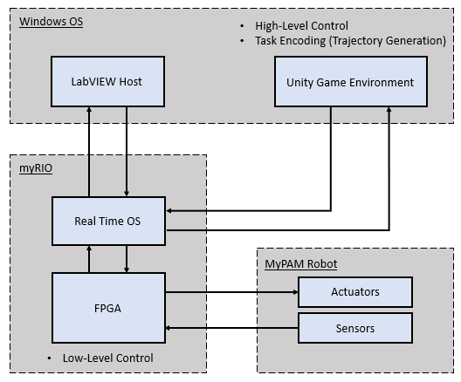
MyPAM – Current Architecture
Notes:
RealTime OS on myRIO communicates with Unity via TCP

Slide 9
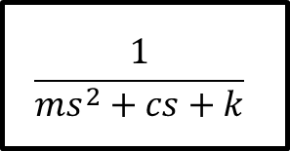
Admittance Control
Admittance filter
$$\frac{1}{{ms}^{2}+cs+k}$$
F_{ext}
Position
Demand
(P_{D})
Desired
Position
(P_{T})
+
Position
Controller
Plant
+
-
Actual position (P_{A})

Slide 10
Impedance Control

